Slide 1


Anti-Bullying
Week 2021

Slide 2
?
What is bullying?
Bullying is the repetitive, intentional hurting of one person or group by another person or group, where the relationship involves an imbalance of power. It can happen face to face or online.
Video: https://youtu.be/U8iX-rstY9I
Anti-Bullying Week 2021 – One Kind Word
2

Slide 3
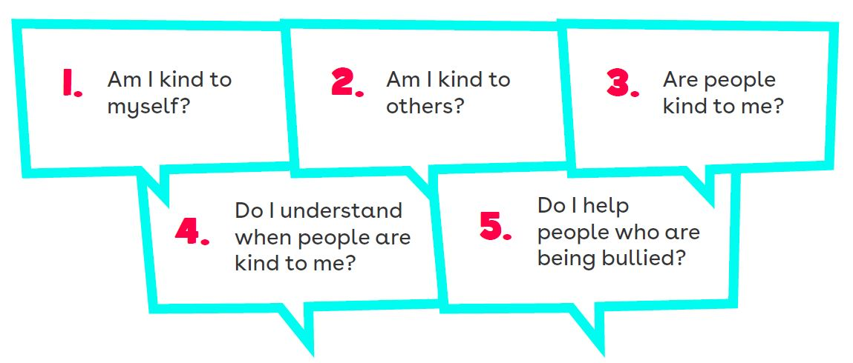
5 Key Kindness Questions
Anti-Bullying Week 2021 – One Kind Word
3

Slide 4
Situation
2
Tom joined school half way through the year. You saw him sitting on a table on his own and you often hear other pupils call him gay.
What could you do to spread kindness and stop bullying?
Anti-Bullying Week 2021 – One Kind Word
4

Slide 5
Situation
3
Harry trips Aiden every time he walks down the school corridor. Everyone laughs but teachers don’t seem to notice. You’re worried Harry will pick on you if you do anything but you want to help Aiden.
What could you do to spread kindness and stop bullying?
Anti-Bullying Week 2021 – One Kind Word
5

Slide 6
Situation
4
Leon tells Daniel that he thinks he’s ‘weird’ in front of you. He starts really laying in to him and it’s really awkward and over the top. Daniel looks shocked and upset.
What could you do to spread kindness and stop bullying?
Anti-Bullying Week 2021 – One Kind Word
6

Slide 7
?
Is it possible to disagree kindly?
Think / Pair / Share
Anti-Bullying Week 2021 – One Kind Word
7

Slide 8
?
Write your tips about how we can disagree in a kind way
Think / Pair / Share
Anti-Bullying Week 2021 – One Kind Word
8

Slide 9

“
Our school is a kind school
“
Let’s discuss
Anti-Bullying Week 2021 – One Kind Word
9

Slide 10
Thank you for being a part of
Anti-Bullying
Week 2021

